Slide 1
zekeLabs
Kafka - Basics
Learning made Simpler ! www.zekeLabs.com

Slide 2
Messages & Batches
Schemas
Topics & Partitions
Cassandra Features
Cassandra Use Cases/Application
Agenda

Slide 3
Messages & Batches
Each unit of data is known as message.
Message can optionally have key
Batch is collection of messages of same topic & partition

Slide 4
Schemas
While messages are opaque byte arrays to Kafka itself, it is recommended that additional structure, or schema, be imposed on the message content so that it can be easily understood.
Many Kafka developers favor the use of Apache Avro, which is a serialization framework originally developed for Hadoop.

Slide 5
Topics & Partitions
Each Topic is broken down into partitions
Per topic per partition is ordered & not across partitions.
Partitions are also the way that Kafka provides redundancy
and scalability.
Each partition can be hosted on a different server, which means that a single topic can be scaled horizontally across multiple servers to provide performance far beyond the ability of a single server.

Slide 6
Producers & Consumers
Message will be produced on a specific topic.
Least bothered about partitions

Slide 7
Broker & Cluster
Single kafka server is broker
The broker receives messages from producers,assigns offsets to them, and commits the messages to storage on disk.
It also services consumers, responding to fetch requests for partitions and responding with the messages that have been committed to disk.
Brokers are designed to be part of clusters

Slide 8
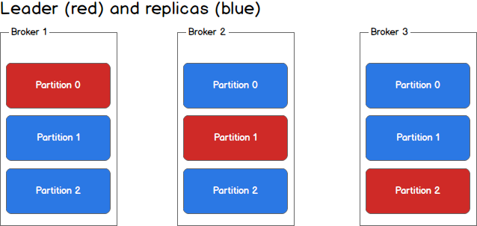
More ...
Within a cluster of brokers, one broker will also function as the cluster controller.
The controller is responsible for administrative operations, including assigning partitions to brokers and monitoring for broker failures.

Slide 9
Serializers
When the object you need to send to Kafka is not a simple string or integer, you have a choice of either using a generic serialization library like Avro, Thrift, or Protobuf to create records, or creating a custom serialization for objects you are already using.

Slide 10
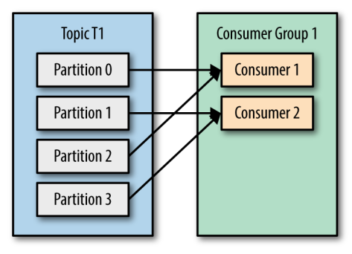
Parallelizing Consumers
ConsumerGroup

Slide 11
Partition Rebalance
When we add a new consumer to the group, it starts consuming messages from partitions previously consumed by another consumer.
The same thing happens when a consumer shuts down or crashes; it leaves the group, and the partitions it used to consume will be consumed by one of the remaining consumers.
Moving partitioner ownership between different consumers is known as rebalance

Slide 12
poll loop
Heart of the consumer consist of infinite for loop polling information from server.

Slide 13
Cluster Membership
Kafka uses Apache Zookeeper to maintain the list of brokers that are currently members of a cluster.
Each broker has a unique broker-id
Controller is one of the broker responsible for selecting leader of partitions.
When other brokers start, they also try to create this node, but receive a “node already exists” exception, which causes them to “realize” that the controller node already exists and that the cluster already has a controller.

Slide 14
Replication
Each topic is partitioned, and each partition can have multiple replicas.
Those replicas are stored on brokers, and each broker typically stores hundreds or even thousands of replicas belonging to different topics and partitions.
Two types of replica - leader & follower.

Slide 15
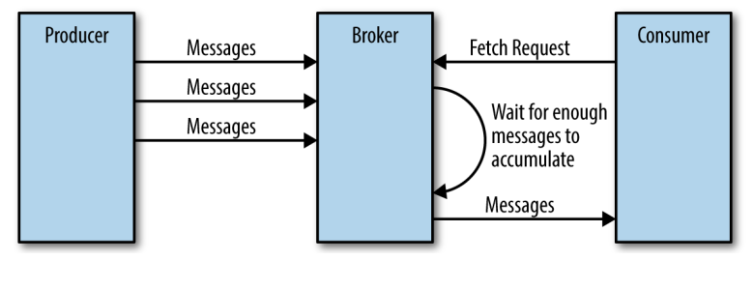
Request Processing
Producer Request
Fecth Request
Other Request

Slide 16
Physical Storage - Partition Allocation
6 brokers, 10 partitions & replication factor 3. Total 30 partitions.
Best case is 5 replicas per broker.
For each partition, each replica is in seperate broker.

Slide 17
Thank You !!!

Slide 18
THANK YOU
Let us know how can we help your organization to Upskill the employees to stay updated in the ever-evolving IT Industry.
Get in touch:
www.zekeLabs.com | +91-8095465880 | info@zekeLabs.com
Visit : www.zekeLabs.com for more details

